Slide 1
MIS 637
Data Analytics & Machine Learning
C4.5 Algorithm
M. Daneshmand
MD-MIS 637-Fall 2020

Slide 2
C4.5 Algorithm
  C4.5 uses information gain or entropy reduction to select optimal split at each decision node
  In Engineering, information analogous to signal, entropy analogous to noise
What is Entropy?
  Event with probability = p, average amount of information, in bits, required to transmit result –log2(p)
  For example, toss fair coin with p = 0.5
  Result of toss transmitted using –log2(0.5) = 1 bit of information
  1 bit of information represents result toss as 0 or 1
  Corresponds to either “HEAD” or “TAIL”
MD-MIS 637-Fall 2020

Slide 3
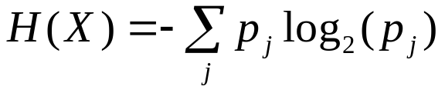
C4.5 Algorithm (cont’d)
  Variable X has k values with probabilities p1, p2, ... , pk
  For variables with several outcomes, use weighted sum of
  –log2(p)’s to transmit result
  Entropy of X defined using formula:
  Represents smallest number of bits, on average per symbol, needed to transmit stream of symbols corresponding to observed values of X
MD-MIS 637-Fall 2020

Slide 4
C4.5 Algorithm (cont’d)
Information Gain
  Suppose we have a candidate split S, which partitions the data in to k subsets: T1, T2, …Tk
  Weighted sum of the entropies: Sum Pi times Hs(Ti) = Hs(T), where Pi is the proportion of records in subset i
  C4.5’s uses Information Gain
  gain(S) = H(T) – HS(T)
  Represents increase in information by partitioning training data T according to candidate split S
  For each candidate split, C4.5 chooses split that has maximum information gain, gain(S)
Example
  C4.5 illustrated with example
  Recall the data set where customer classified “Good” or “Bad” credit risk using three predictor fields
MD-MIS 637-Fall 2020

Slide 5
C4.5 Algorithm (cont’d)
Customer | Savings | Assets | Income ($1000s) | Credit Risk
1 | Medium | High | 75 | Good
2 | Low | Low | 50 | Bad
3 | High | Medium | 25 | Bad
4 | Medium | Medium | 50 | Good
5 | Low | Medium | 100 | Good
6 | High | High | 25 | Good
7 | Low | Low | 25 | Bad
8 | Medium | Medium | 75 | Good
  Consider all candidate splits for root node shown below
Candidate Split | Child Nodes
1 | Savings = Low | Savings = Medium |  | Savings = High
2 | Assets = Low | Assets = Medium |  | Assets = High
3 | Income <= $25,000 |  | Income > $25,000
4 | Income <= $50,000 |  | Income > $50,000
5 | Income <= $75,000 |  | Income > $75,000
MD-MIS 637-Fall 2020

Slide 6
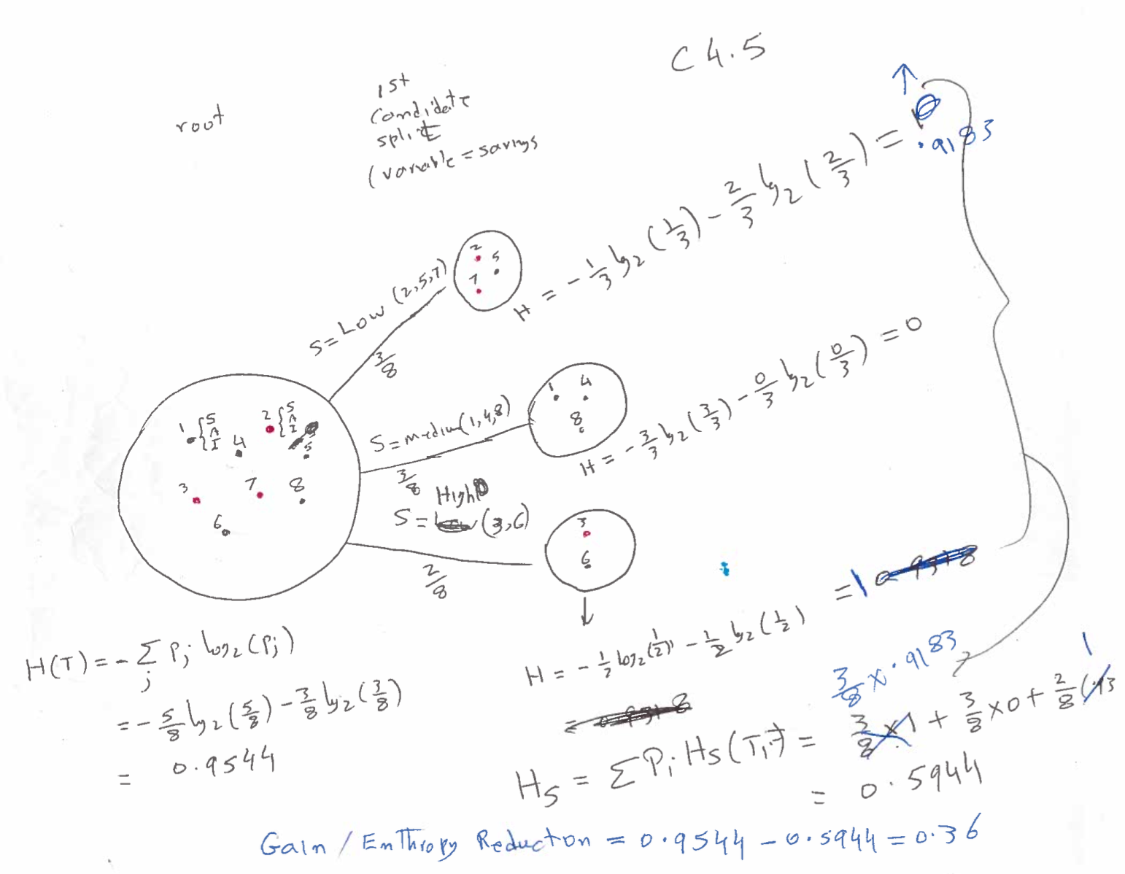
MD-MIS 637-Fall 2020

Slide 7
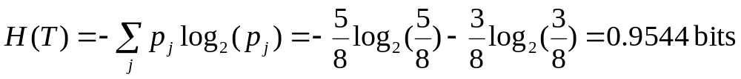
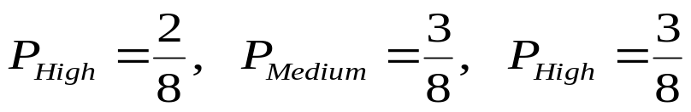
C4.5 Algorithm (cont’d)
  Calculate Entropy of training set before splitting, where 5/8 records classified “Good” and 3/8 “Bad”
  Compare each candidate split against H(T) = 0.9544, to determine which split maximizes information gain
  Candidate 1
  Split on Savings, “High” = 2 records, “Medium” = 3 records, and “Low” = 3 records:
MD-MIS 637-Fall 2020

Slide 8
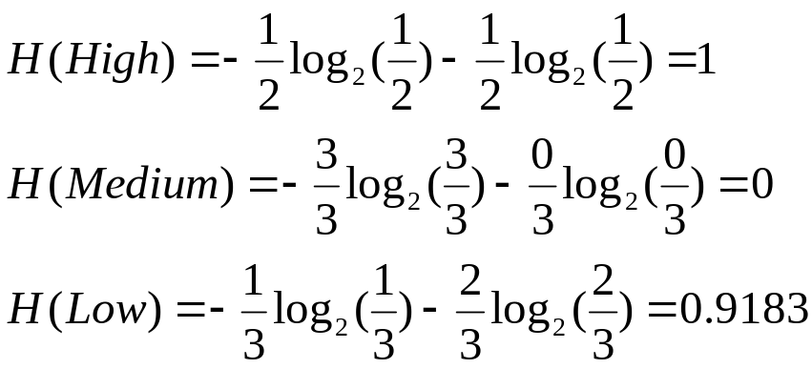
C4.5 Algorithm (cont’d)
  Of records Savings = “High”, 1 is “Good” and 1 is “Bad”. P = 0.5 of choosing “Good” record
  Where Savings = “Medium”, 3 are “Good”, so P = 1.0 choosing “Good”
  Of records Savings = “Low”, 1 is “Good” and 2 are “Bad”. This results P = 0.33 choosing “Good”
  Entropy of 3 branches, “High”, “Medium”, and “Low”, are:
MD-MIS 637-Fall 2020

Slide 9
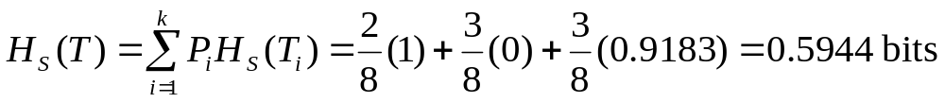
C4.5 Algorithm (cont’d)
  Combining Entropy for three branches, along with corresponding proportion Pi:
  Information Gain represented by split on Savings attribute is H(T) – HSavings(T) = 0.9544 – 0.5944 = 0.36 bits
  How is measure interpreted?
  Before split, H(T) = 0.9544 bits, on average. Takes 0.9544 bits of information to transmit credit risk associated with 8 records
MD-MIS 637-Fall 2020

Slide 10
C4.5 Algorithm (cont’d)
  Splitting on Savings results in HSavings(T) = 0.5944. Now, on average, fewer bits of information required to transmit credit risk associated with 8 records
  Reduction in Entropy is Information Gain, 0.9544 – 0.5944 = 0.36 bits of information gained by splitting on Savings
  C4.5 chooses attribute split with highest Information Gain as optimal split at root node
  Information Gain for other 4 candidate splits calculated similarly
MD-MIS 637-Fall 2020

Slide 11
C4.5 Algorithm (cont’d)
  Information Gain for 5 candidate splits occurring at root node summarized below
  Candidate split 2 has highest Information Gain = 0.5487 bits, and chosen for initial split
Candidate Split | Child Nodes | Information Gain (Entropy Reduction)
1 | Savings = Low Savings = Medium Savings = High | 0.36 bits
2 | Assets = Low Assets = Medium Assets = High | 0.5487 bits
3 | Income <= $25,000 Income > $25,000 | 0.1588 bits
4 | Income <= $50,000 Income > $50,000 | 0.3475 bits
5 | Income <= $75,000 Income > $75,000 | 0.0923 bits
MD-MIS 637-Fall 2020

Slide 12
C4.5 Algorithm (cont’d)
  Initial split results in two terminal leaf nodes and one second-level decision node
  Records with Assets = “Low” and Assets = “High” have same target class value, “Bad” and “Good”, respectively
  C4.5 iterates at Decision Node A, choosing optimal split from list of four possible candidate splits
Root Node (All Records)
Assets = Low, Medium, High?
Assets = Low
Assets = Medium
Assets = High
Bad Risk
(Records 2, 7)
Decision Node A
(Records 3, 4, 5, 8)
Good Risk
(Records 1, 6)
MD-MIS 637-Fall 2020

Slide 13
C4.5 Algorithm (cont’d)
Root Node (All Records)
Assets = Low, Medium, High?
  After growing tree, C4.5 performs pessimistic postpruning, if necessary. Increases generality of tree
  Diagram shows fully-grown C4.5 tree. “bushier” and one level shallower, compared to tree build by CART
  Both algorithms concur on importance of Assets (root level) and Savings (second level)
Assets = Low
Assets = Medium
Assets = High
Bad Risk
(Records 2, 7)
Decision Node A
(Records 3, 4, 5, 8)
Good Risk
(Records 1, 6)
Savings = Low
Savings =Medium
Savings = High
Good Risk
(Records 5)
Good Risk
(Records 4, 8)
Bad Risk
(Records 3)
MD-MIS 637-Fall 2020

Slide 14
Decision Rules
  Decision Trees produce interpretable output in human-readable form
  Decision Rules constructed directly from Decision Tree output, traversing path from root node to a given leaf node
  Decision Rules have form IF antecedent THEN consequent
  Antecedent consists of attributes values from branches of given path
  Consequent is classification of records contained in particular leaf node, corresponding to path
MD-MIS 637-Fall 2020

Slide 15
Decision Rules (cont’d)
  Recall the full decision tree produced by C4.5. Table below shows Decision Rules associated with tree
  Support of decision rule shows proportion of records in training set resting in leaf node
  Confidence is percentage of records in leaf node, for which decision rule is true
  Although confidence levels reported = 100%, results not typical of real-world examples
Antecedent | Consequent | Support | Confidence
If assets = low | then bad credit risk. | 2/8 | 1.00
If assets = high | then good credit risk. | 2/8 | 1.00
If assets = medium and savings = low | then good credit risk. | 1/8 | 1.00
If assets = medium and savings = medium | then good credit risk. | 2/8 | 1.00
If assets = medium and savings = high | then bad credit risk. | 1/8 | 1.00
MD-MIS 637-Fall 2020

